Slide 1
ANALYSIS ON GLOBAL TERRORISM DATASET USING EXCEL DASHBOARD
- Uttam Kumar

Slide 2
PROBLEM STATEMENTS
What are the total number of attack in each/all years?
Which country has been hit the most by terrorist attacks?
What type attack has been done by a terrorists?
What are the total number of attack in region?
Target by terrorist.
Which group has been attack the most?

Slide 3
PROBLEM STATEMENT 1 What are the total number of attack in each/all years?
INSIGHTS:
Maximum number of attack in year 2014. (value 16694)

Slide 4
PROBLEM STATEMENT 2 Which country has been hit the most by terrorist attacks?
INSIGHTS :
IRAN, PAKISTAN, and INDIA have been hit the most by terrorist attack.

Slide 5
PROBLEM STATEMENT 3 What type attack has been done by a terrorists?
INSIGHTS:
Most of attack type is bombing or explosion done by terrorist.

Slide 6
PROBLEM STATEMENT 4 What are the total number of attack in region?
INSIGHTS:
Most of the attacks in South Asia(24%).

Slide 7
PROBLEM STATEMENT 5 Target by terrorist
INSIGHTS:
Mostly private citizen & property have targeted by terrorist.

Slide 8
PROBLEM STATEMENT 5 Which group has been attack the most?
INSIGHTS:
Most of the attack has been by unknown group.

Slide 9
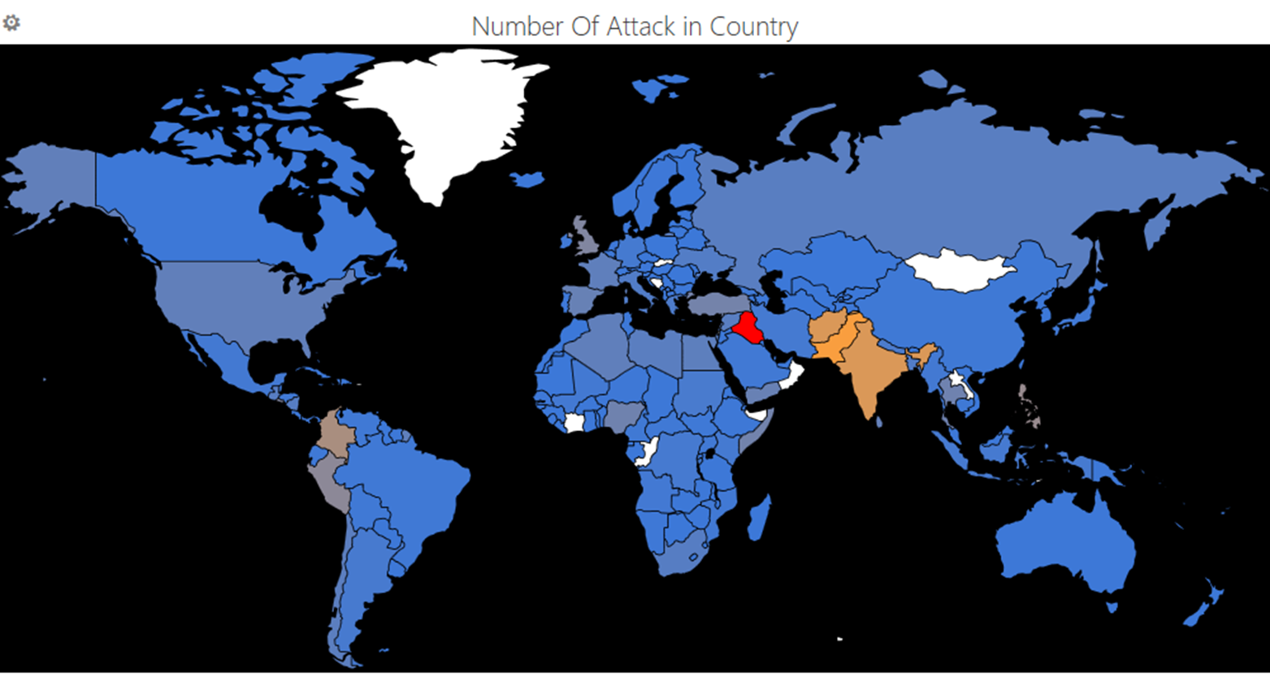
TO VIEW MAP

Slide 10
THANK YOU

